Slide 1

نحوه اپروچ به خانم باردار با فشارخون بالا در ویزیت‌های بارداری در درمانگاه پزشکی خانواده
ارایه دهنده دکتر مارکو بروتا
استاد راهنما: سرکار خانم دکتر بندریان
1401/10/22

Slide 2
Present Illness
29 year old Female present with CC of high blood pressure of 150/90 during her routine check-up on 24th week of pregnancy.
G2P1L1

Slide 3
History and P.E
PMH: -
PSH: c/section (3 yrs ago)
DH: -
HH: social smoker
AH: -
FH: -

Slide 4
History and P.E
v/s: BP (150/90) PR (90) RR (22) T (37.1 C) SpO2 (96%)
PH/E:
Lungs clear w/o muffle
Heart: S1,S2 w/o murmur
Abdomen: soft w/o tenderness
Limbs: symmetrical pulse felt on all 4 limbs

Slide 5
Preeclampsia
Preeclampsia is a serious blood pressure condition that develops during pregnancy.
People with preeclampsia often have high blood pressure (hypertension) and high levels of protein in their urine (proteinuria).
Preeclampsia typically develops after the 20th week of pregnancy.
It can also affect other organs in the body and be dangerous for both the mom and her developing fetus.
Because of these risks, preeclampsia needs to be treated by a healthcare provider.

Slide 6
What happens when you have preeclampsia?
When you have preeclampsia,
your blood pressure is elevated (higher than 140/90 mmHg)
and high levels of protein in urine
Preeclampsia puts stress on heart and other organs and can
cause serious complications
It can also affect the blood supply to placenta
impair liver and kidney function or
cause fluid to build up in your lungs

Slide 7
Who gets preeclampsia?
Preeclampsia may be more common in first-time mothers (Prim gravid)
Healthcare providers are not entirely sure why some people develop preeclampsia. Some factors that may put you at a higher risk are:
• History of high blood pressure
kidney disease
Diabetes
Expecting multiples
Family history of preeclampsia.
Autoimmune conditions like lupus.
Obesity

Slide 8
Severe preeclampsia
•Hypertensive emergency (blood pressure is 160/110 mmHg or higher)
• Decreased kidney or
liver function
• Fluid in the lungs(Pulmonary Edema)
• Low blood platelet levels (thrombocytopenia)
• Decreased urine production( Rise in creatine)

Slide 9

• The defining feature of preeclampsia is high blood pressure, proteinuria, or other signs
of damage to the kidneys or other organs
The first signs of preeclampsia are often detected during routine prenatal visits with a health care provider
Severe headaches
• Changes in vision, including temporary loss of vision, blurred vision or light sensitivity
• Shortness of breath, caused by fluid in the lungs
• Pain in the upper belly, usually under the ribs on the right side
• Nausea or vomiting
Weight gain and swelling (edema) are typical during healthy pregnancies.
However, sudden weight gain or a sudden appearance of edema —
particularly in face and hands — may be a sign of preeclampsia

Slide 10
SIGNS
Along with high blood pressure, preeclampsia signs and symptoms may include:
• Excess protein in urine (proteinuria) or other signs of kidney problems (↑Cr)
• Decreased levels of platelets in blood (thrombocytopenia)
• Increased liver enzymes that indicate liver problems

Slide 11
DIAGNOSIS AND TESTS
Preeclampsia is often diagnosed during routine prenatal appointments when healthcare provider check weight gain, blood pressure and urine.
If preeclampsia is suspected, healthcare provider must:
• Order additional blood tests to
check kidney and
check liver functions (AST,ALT, BILI,PT,PTT)
check CBC
• Perform an ultrasound and other fetal monitoring
to look at the size of the fetus and
assess the amniotic fluid volume
Perform fetal monitoring (NST)

Slide 12
PREVENTION
For people with risk factors, there are some steps that can be taken prior to and during pregnancy to lower the chance of developing preeclampsia. These steps can include:
• Losing weight if you have overweight/obesity (prior to pregnancy-related weight gain).
• Controlling blood pressure and blood sugar (if you had high blood pressure or diabetes prior to pregnancy)
• Maintaining a regular exercise routine
• Getting enough sleep
• Eating healthy foods that are low in salt and avoiding caffeine.
Can you prevent preeclampsia?
Taking a baby aspirin daily has been to decrease risk of developing preeclampsia by
approximately 15%.
If patient at risk for preeclampsia, healthcare provider may recommend
starting aspirin 80 mg in early pregnancy (by 12 weeks gestation)

Slide 13
Causes
The exact cause of preeclampsia likely involves several factors.
Experts believe it begins in the placenta — the organ that nourishes the fetus throughout pregnancy
Early in a pregnancy, new blood vessels develop and evolve to supply oxygen and nutrients to the placenta.
In women with preeclampsia, these blood vessels don't seem to develop or work properly. Problems with how well blood circulates in the placenta may lead to the irregular regulation of blood pressure in the mother.

Slide 14
DDX
Other high blood pressure disorders during pregnancy
Preeclampsia is one high blood pressure (hypertension) disorder that can occur during pregnancy. Other disorders can happen, too:
• Gestational hypertension is high blood pressure that begins after 20 weeks without problems in the kidneys or other organs
Some women with gestational hypertension may develop preeclampsia
• Chronic hypertension is high blood pressure that was present before pregnancy or that occurs before 20 weeks of pregnancy
High blood pressure that continues more than three months after a pregnancy also is
called chronic hypertension.
• Chronic hypertension with superimposed preeclampsia occurs in women diagnosed with chronic high blood pressure before pregnancy, who then develop worsening high blood pressure and protein in the urine or other health complications during pregnancy

Slide 15
Conditions that are linked to a higher risk of preeclampsia
• Preeclampsia in a previous pregnancy
• Being pregnant with more than one baby
• Chronic high blood pressure (hypertension)
• Type 1 or type 2 diabetes before pregnancy
• Kidney disease
• Autoimmune disorders
• Use of in vitro fertilization

Slide 16
Conditions that are associated with a moderate risk of developing preeclampsia include:
• First pregnancy with current partner
• Obesity
• Family history of preeclampsia
• Maternal age of 35 or older
• Complications in a previous pregnancy
• More than 10 years since previous pregnancy
For the purposes of making decisions about prevention strategies, a Black woman or a woman with a low income has a moderately increased risk of developing preeclampsia.

Slide 17
Complications
Pregnancy complication:
Fetal growth restriction. Preeclampsia affects the arteries carrying blood to the placenta. If the placenta doesn't get enough blood, the baby may receive inadequate blood and oxygen and fewer nutrients. This can lead to slow growth known as fetal growth restriction.
• Preterm birth. Preeclampsia may lead to an unplanned preterm birth — delivery before 37 weeks. Also, planned preterm birth is a primary treatment for preeclampsia. A baby born prematurely has increased risk of breathing and feeding difficulties, vision or hearing problems, developmental delays, and cerebral palsy. Treatments before preterm delivery may decrease some risks.
• Placental abruption. Preeclampsia increases your risk of placental abruption. With this condition, the placenta separates from the inner wall of the uterus before delivery. Severe abruption can cause heavy bleeding, which can be life-threatening for both the mother and baby.

Slide 18
COMPLICATION
• MOTHER
Eclampsia
the onset of seizures or coma with signs or symptoms of preeclampsia.
It is very difficult to predict whether a patient with preeclampsia will develop eclampsia.
Eclampsia can happen without any previously observed signs or symptoms of preeclampsia.
Signs and symptoms that may appear before seizures include
severe headaches
vision problems
mental confusion or altered behaviors.
But, there are often no symptoms or warning signs.
Eclampsia may occur before, during or after delivery (Until 42 days after delivery)

Slide 19
Complication
• HELLP syndrome. HELLP stands for
hemolysis (the destruction of red blood cells)
elevated liver enzymes
low platelet count
This severe form of preeclampsia affects several organ systems
HELLP syndrome is life-threatening to the mother and baby, and it may cause lifelong health problems for the mother.
Signs and symptoms include
nausea and vomiting, headache, upper right belly pain, and a general feeling
of illness or being unwell
Sometimes, it develops suddenly, even before high blood pressure is detected
It also may develop without any symptoms

Slide 20
Complications
• Other organ damage. Preeclampsia may result in damage to
the kidneys, liver, lung, heart, or eyes
may cause a stroke or other brain injury
The amount of injury to other organs depends on how severe the preeclampsia is.
• Cardiovascular disease.
Having preeclampsia may increase your risk of future heart and blood vessel
(cardiovascular) disease.
The risk is even greater if you've had preeclampsia more than once or you've had
a preterm delivery.

Slide 21
faq
Does stress cause preeclampsia?
While stress may impact blood pressure, stress is not one of the direct causes of preeclampsia. While some stress is unavoidable during pregnancy, avoiding high-stress situations or learning to manage your stress is a good idea.
What week of pregnancy does preeclampsia start?
Preeclampsia typically occurs after 20 weeks of pregnancy, but it can come earlier.
Most preeclampsia occurs at or near term (37 weeks gestation)
Preeclampsia can also come after delivery (postpartum preeclampsia), which usually occurs between the first few days to one week after delivery.
In rare cases, it begins weeks after delivery.
Will preeclampsia affect baby?
Preeclampsia can cause preterm delivery (your baby needing delivered early).
Premature babies are at increased risk for health complications like low birth weight and respiratory issues.

Slide 22
faq
Does preeclampsia go away after delivery?
Preeclampsia typically goes away within days to weeks following delivery.
Sometimes, blood pressure can remain high for a few weeks after delivery, requiring treatment with medication. Your healthcare provider will work with you after your pregnancy to manage your blood pressure.
People with preeclampsia — particularly those who develop the condition early in pregnancy — are at greater risk for high blood pressure (hypertension) and heart disease later in life.
Knowing this information, those individuals can work with their primary care provider to take steps to reduce these risks.

Slide 23
What's the difference between preeclampsia and eclampsia?
Eclampsia is severe preeclampsia that causes seizures.
It's considered a complication of preeclampsia, but it can happen without signs
of preeclampsia. In rare cases, it can lead to coma, stroke or death.
What is postpartum preeclampsia?
Postpartum preeclampsia is when you develop preeclampsia after your baby is born.
It typically happens within two days of giving birth but can also develop several weeks later.
The signs of postpartum preeclampsia are similar to preeclampsia and include swelling in limbs and extremities, headaches, seeing spots, stomach pains and nausea
It's a serious condition that can cause seizures, stroke and organ damage.

Slide 25
treatemt
If the pregnancy is at 37 weeks or later, the healthcare provider will usually want to deliver the fetus to treat preeclampsia and avoid further complications.
If the pregnancy is at less than 37 weeks, however, the woman and her healthcare provider may consider treatment options that give the fetus more time to develop, depending on how severe the condition is. A healthcare provider may consider the following options:
If the preeclampsia is mild, it may be possible to wait to deliver. To help prevent further complications, the healthcare provider may ask the woman to go on bed rest to try to lower blood pressure and increase blood flow to the placenta.
Close monitoring of the woman and her fetus will be needed.
Tests for the mother might include blood and urine tests to see if the preeclampsia is progressing, such as
tests to assess platelet counts, liver enzymes, kidney function, and urinary protein levels.
Tests for the fetus might include ultrasound, heart rate monitoring, assessment of fetal growth,
and amniotic fluid assessment.

Slide 26
Anticonvulsive medication, such as magnesium sulfate, might be used to prevent a seizure.
I. In some cases, such as with severe preeclampsia,
the woman will be admitted to the hospital so
she can be monitored closely and continuously.
Treatment in the hospital might include
intravenous medication to control blood pressure and prevent seizures or other complications,
as well as steroid injections to help speed up the development of the fetus's lungs.
II. When a woman has severe preeclampsia and is at 34 weeks of pregnancy or later,
the American College of Obstetricians and Gynecologists recommends delivery as soon as
medically possible.
III. If the pregnancy is at less than 34 weeks,
healthcare providers will probably prescribe corticosteroids to help speed up the maturation of the
fetal lungs before attempting delivery.
Preterm delivery may be necessary, even if that means likely complications for the infant, because of the
risk of severe maternal complications.
The symptoms of preeclampsia usually go away within 6 weeks of delivery

Slide 27
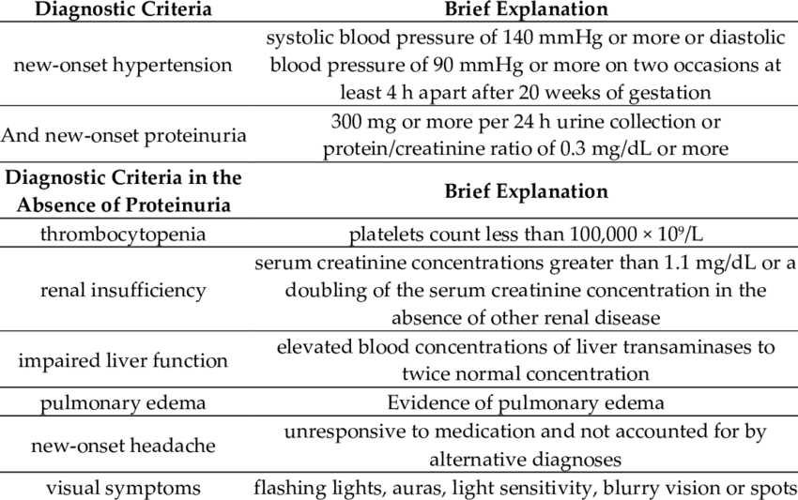

Slide 28
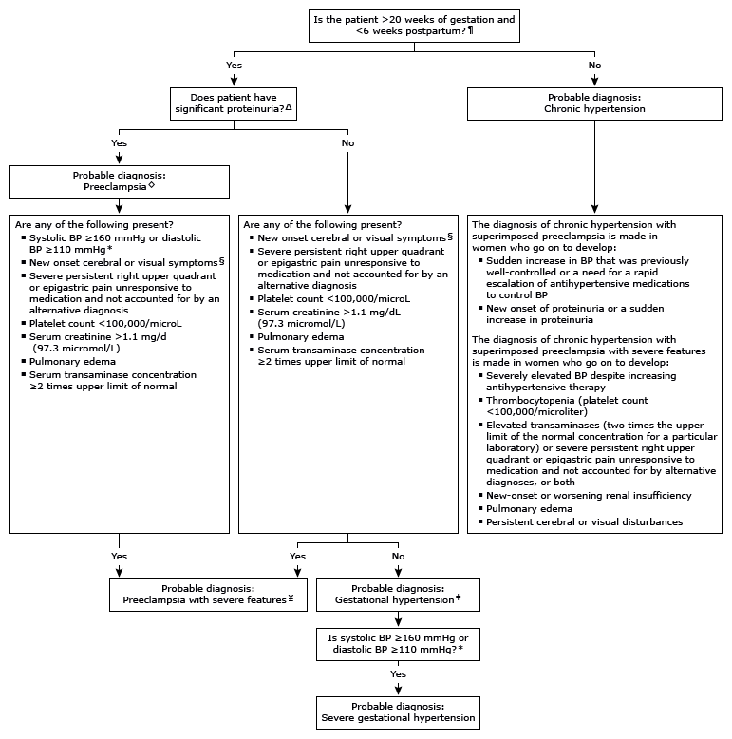

Slide 29
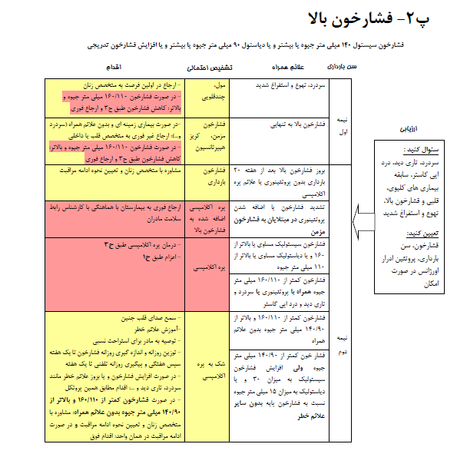

Slide 30
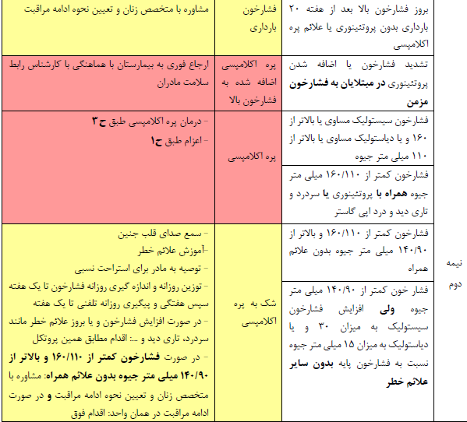
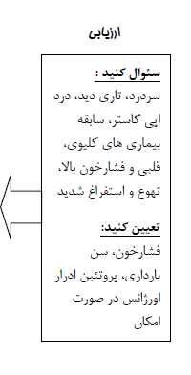

Slide 31
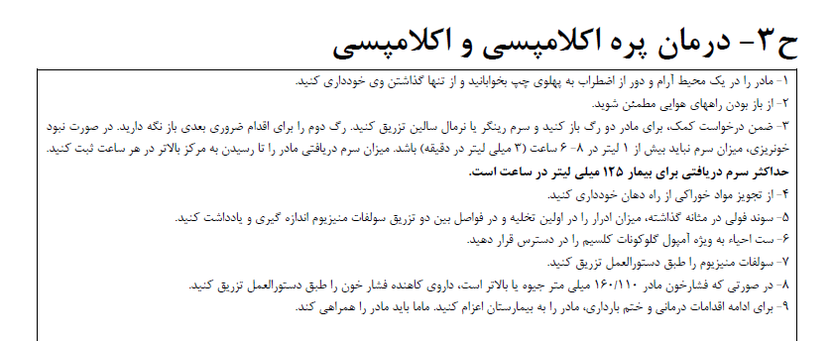

Slide 32
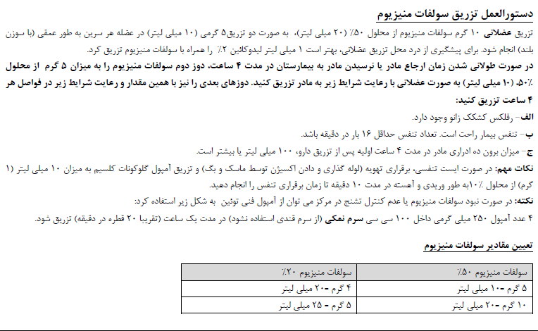

Slide 33
